Slide 1

Introduction
CodeWizards2025
Team Name : Cyber Holder
Theme : Artificial Intelligence and FinTech

Slide 2

Team Detail:-
c
Name of Team leader – Neerav Roy
• Name of Team Members –
Team Detail
• Name of Team leader – Neerav Roy
• Name of Team Members –
Ayush Kumar (Co-leader)
Hritik Kumar
Aryandev
Vishnu Kumar
Ayush Kumar (Co-leader)
Hritik Kumar
Aryandev
Vishnu Kumar

Slide 3
Problem Statement :-
AI-Based Fraud Detection in Online Transactions :-
Design an AI-powered fraud detection system to secure online transactions. By analyzing user behavior, transaction patterns, and device data, the tool detects anomalies in real-time, flagging suspicious activities. Advanced algorithms enable proactive measures against fraud attempts, ensuring customer trust.
Key Challenges in AI-Based Fraud Detection:
Data Issues
Model Performance
Scalability
Security & Privacy
Problem Statement

Slide 4
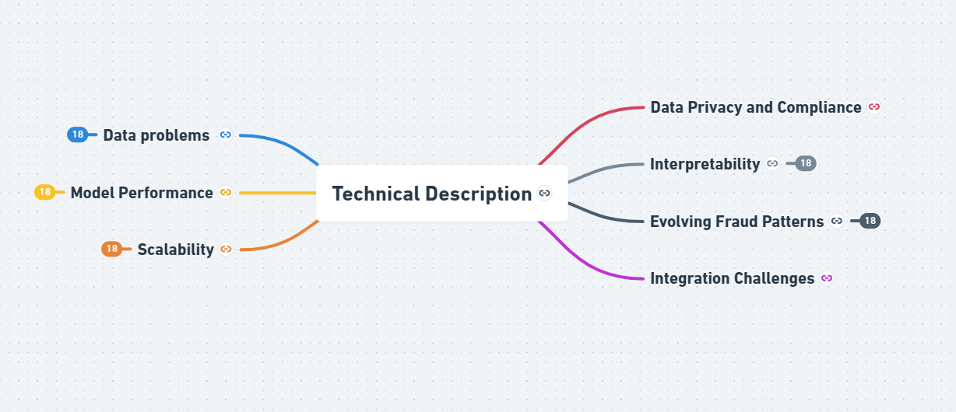

Technical Description :-
Technical Difficulties in Fraud Detection Using AI: Data problems include inadequate quality, imbalanced datasets, and changing fraud trends. Model Performance: Risks of overfitting and false positives or negatives. Scalability: The ability to recognize and handle high-dimensional data in real time. Adversarial attacks and protecting data are two aspects of security and privacy. Interpretability: The inability of intricate AI models to be transparent. Respecting the law and moral principles is known as regulatory compliance.
Technical Description
c
Technical Difficulties in Fraud Detection Using AI:
Data problems include inadequate quality, imbalanced datasets, and changing fraud trends. Model Performance: Risks of overfitting and false positives or negatives. Scalability: The ability to recognize and handle high-dimensional data in real time. Interpretability: The inability of intricate AI models to be transparent.

Slide 5
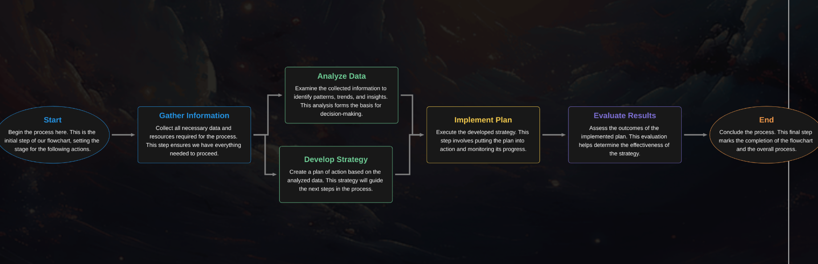
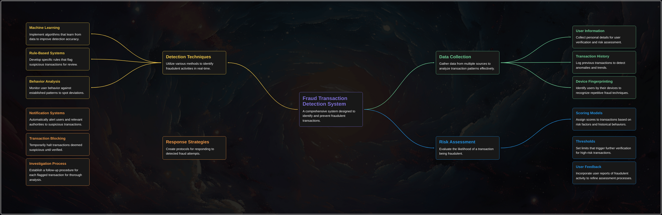
Solution of the Problem

Slide 6
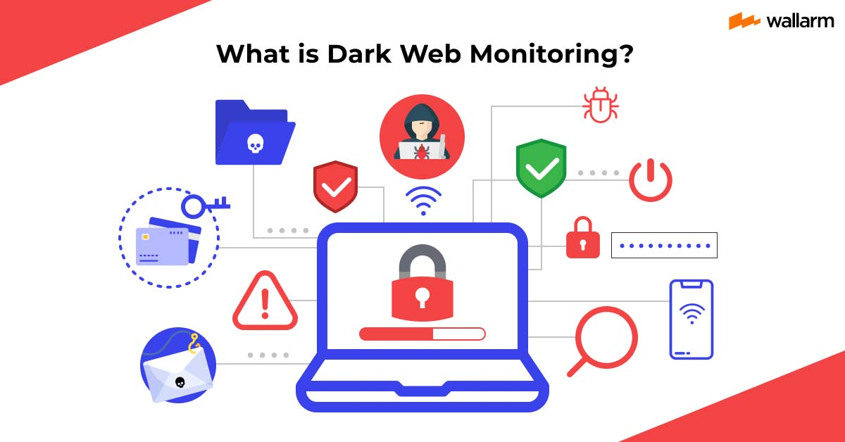
KEY POINTS OF SOLUTION
Improved Data: Arrange and clean the data; if necessary, include more sources.
Smarter Models: Make use of AI and ML that adapt to new trends.
Reduced False Alarms: Increase accuracy by combining rules and cutting-edge AI.
Scalable Systems: For expansion, use cloud and modular architectures.
Remain Compliant: Observe privacy regulations and safeguard data.

Slide 7

Thanks

